Slide 1

Faculty of Sciences of Bizerte
NLP & SEMANTIC MATCHING PROJECT
2026
Sarra Dhouaifi Tharaa Oueslati

Slide 2

Problem Statement
Project Objectives
Dataset
Data Preprocessing
Methodology
Score Calibration
System Architecture
Evaluation Methodology

Slide 3
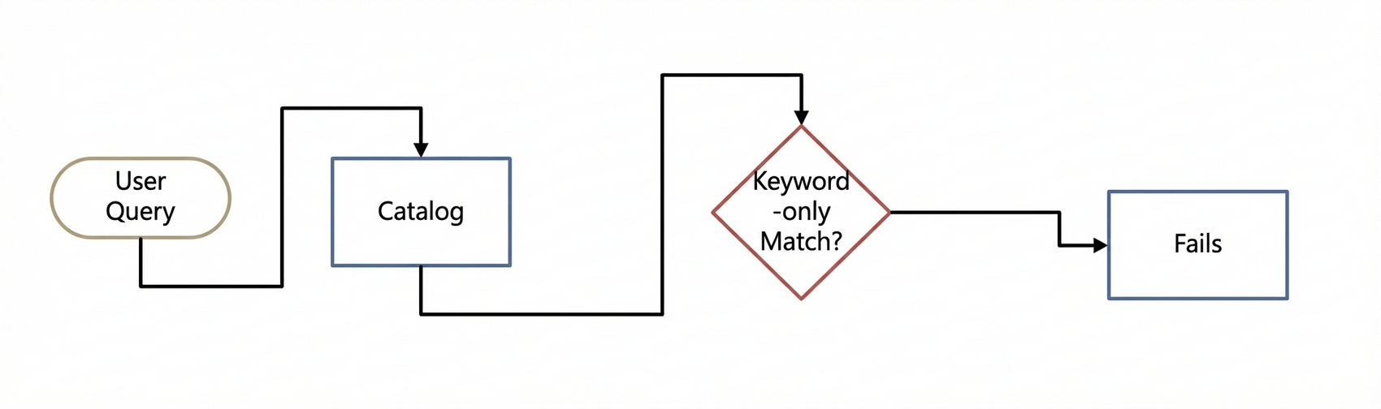
Problem Statement
Users often search for industrial equipment using natural language queries.
Traditional keyword-based searches fail when queries use synonyms or paraphrasing.
Goal: Retrieve the most relevant equipment even when query wording differs from catalog names.

Slide 4
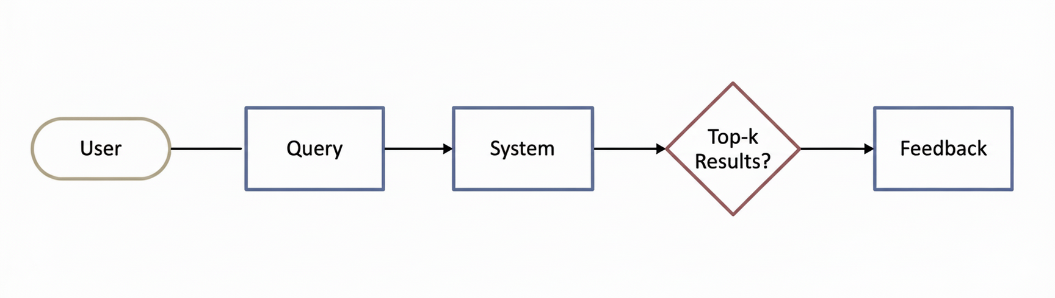
Project Objectives
Build a hybrid retrieval system combining semantic and lexical search.
Provide a REST API for automated evaluation.
Provide a Web UI for manual testing and feedback collection.
Ensure reproducibility using Docker.

Slide 5
Dataset
Synthetic dataset generated using AI to simulate industrial equipment queries.
Files:
equipment_catalog.csv – raw equipment catalog.
equipment_clean.csv – preprocessed equipment names.
test_queries.csv – synthetic test queries.
faiss_index.idx – semantic embeddings index.
faiss_index.idx_mapping.pkl – mapping of IDs to equipment names.

Slide 6
Data Preprocessing
Convert text to lowercase.
Remove accents and special characters.
Remove punctuation and extra whitespace.
Deduplicate equipment entries.
Create a clean text field for embeddings.
equipment_catalog.csv
equipment_clean.csv
id | equipment_name | category
1 | Bosch Electric Screwdriver | Power Tools
2 | Bosch Industrial Screwdriver | Power Tools
3 | Bosch Cordless Drill | Power Tools
id | equipment_name | category | clean_name
1 | Bosch Electric Screwdriver | Power Tools | bosch electric screwdriver
2 | Bosch Industrial Screwdriver | Power Tools | bosch industrial screwdriver
3 | Bosch Cordless Drill | Power Tools | bosch cordless drill 18v

Slide 7

Semantic Search
Methodology
Lexical Fallback & Hybrid
Pipeline Summary

Slide 8
Methodology – Semantic Search
Purpose: Capture meaning of queries beyond exact words.
Algorithm:
Generate embeddings using sentence-transformers/all-MiniLM-L6-v2.
Store embeddings in FAISS Index (IndexFlatL2).
At query time, encode query and retrieve top-k nearest neighbors.
Query → Embedding → FAISS → Top-k Results

Slide 9
Methodology – Lexical Fallback
Purpose: Handle cases where semantic search fails (rare or domain-specific terms).
Algorithm:
Tokenize equipment names into lowercase words.
Build BM25 index over tokenized equipment names.
Compute BM25 scores for the query.
Rank by score and return top-k.
Query → Tokenization → BM25 → Top-k Results

Slide 10
Methodology – Hybrid Search
Purpose: Combine semantic and lexical results for robust retrieval.
Algorithm:
Retrieve top-k semantic results.
Retrieve top-k lexical results.
Merge results and remove duplicates.
Return top-k final results.
Semantic ∪ Lexical → Merged Top-k

Slide 11
Score Calibration
FAISS distances converted to confidence scores in [0,1].
Uses sigmoid function for transformation.
High similarity → high confidence.
Distance → Confidence

Slide 12
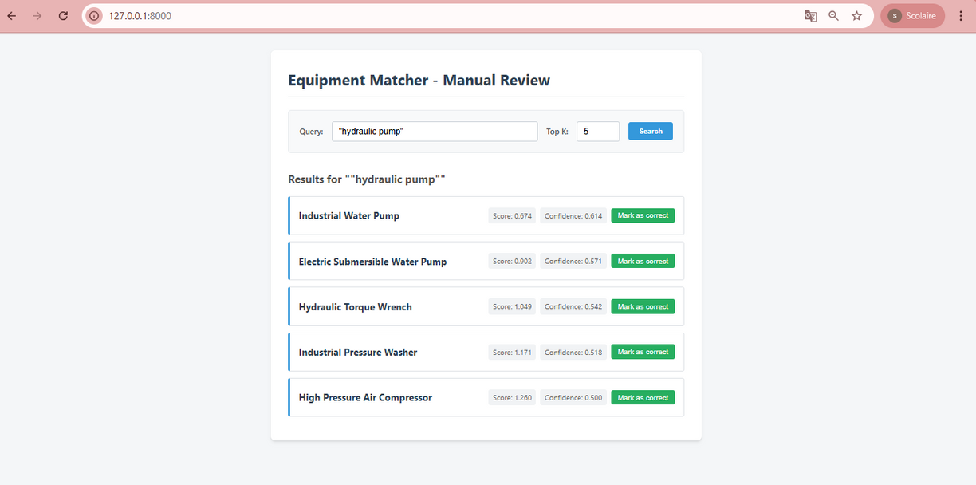
System Architecture
Backend: FastAPI with /evaluate and /feedback endpoints.
Frontend: Web UI for query input and feedback.
Docker ensures reproducible deployment.

Slide 13
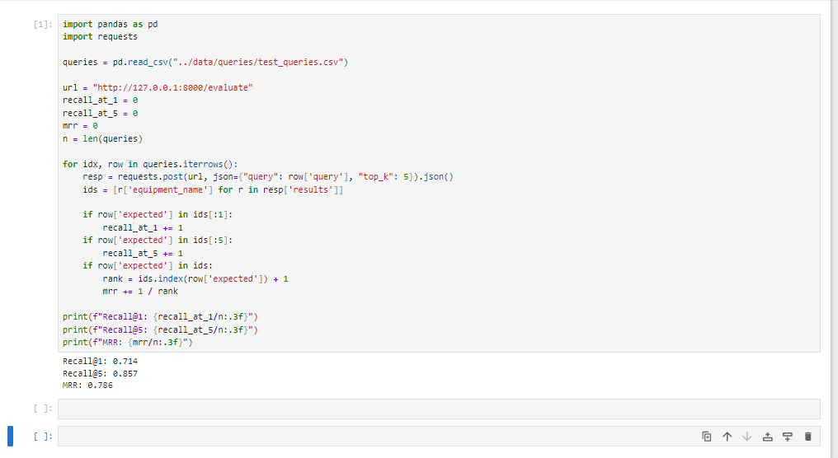
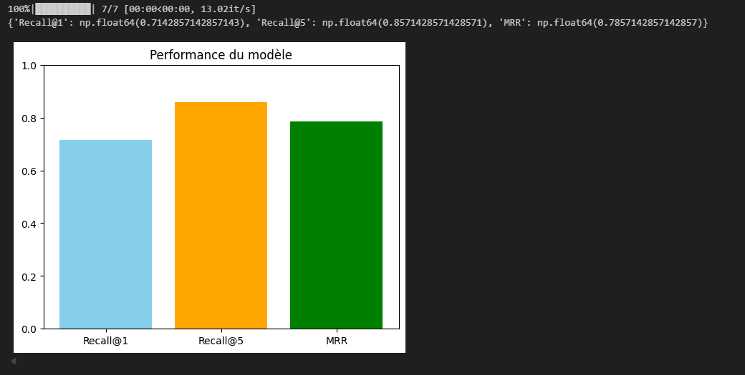
Evaluation Methodology
Automated evaluation via Jupyter notebook (evaluation.ipynb).
Metrics: Recall@1, Recall@5, MRR.
Queries from test_queries.csv.

Slide 14
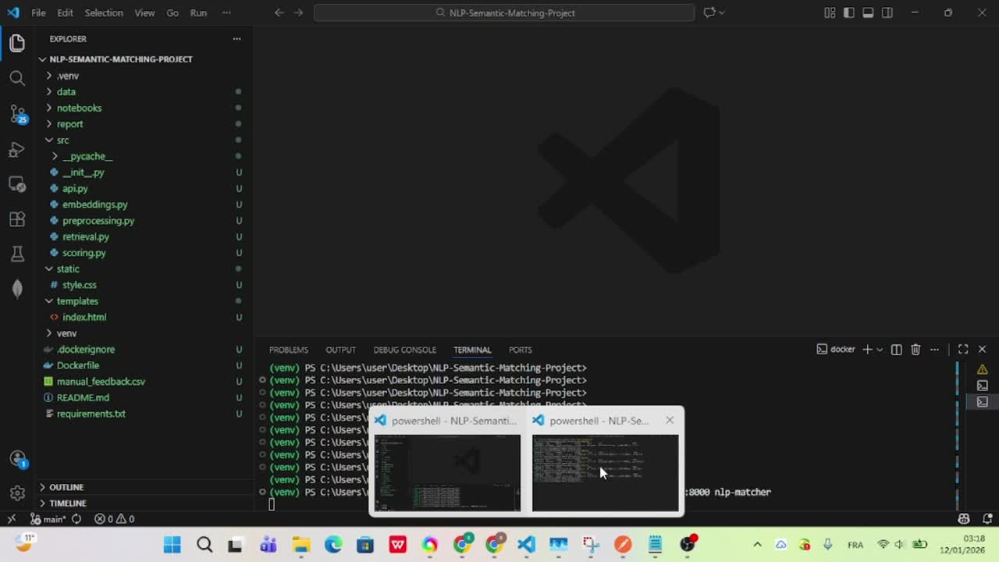
Demonstration

Slide 15
Thank you for your attention

